Slide 1
MEDIA KIT
The Communication Hub: Shapiro-Rouse Lecture
produced by
HANNAH JOHNSON AND LEXY KOHLHEPP

Slide 2
COMPONENTS
Email to the Public
Photo Opp Sheet
Social Media Plan (3 examples)
Flier
Fact Sheet
Backgrounder
Soft News Release
Hard News Release

Slide 3
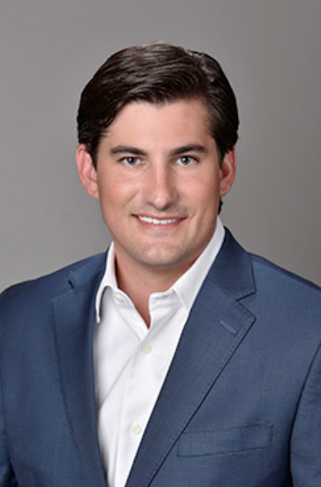
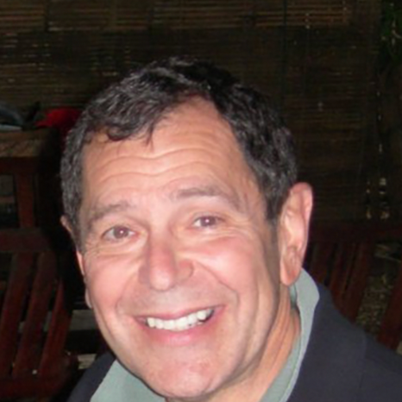
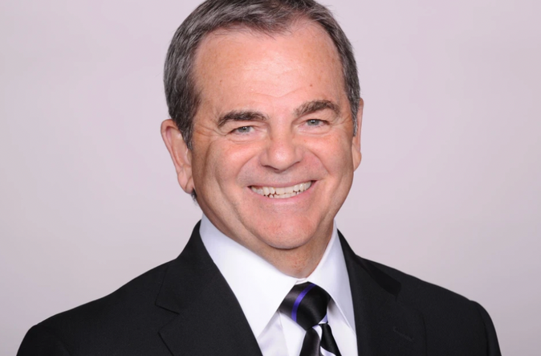
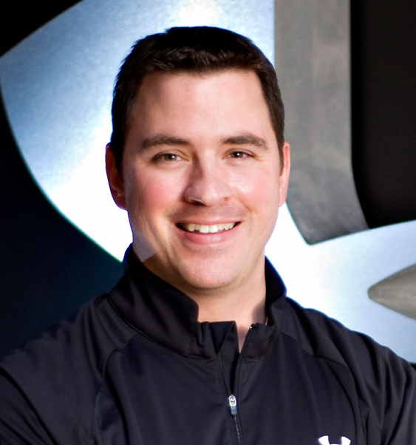
PAST GUEST SPEAKERS

Slide 4
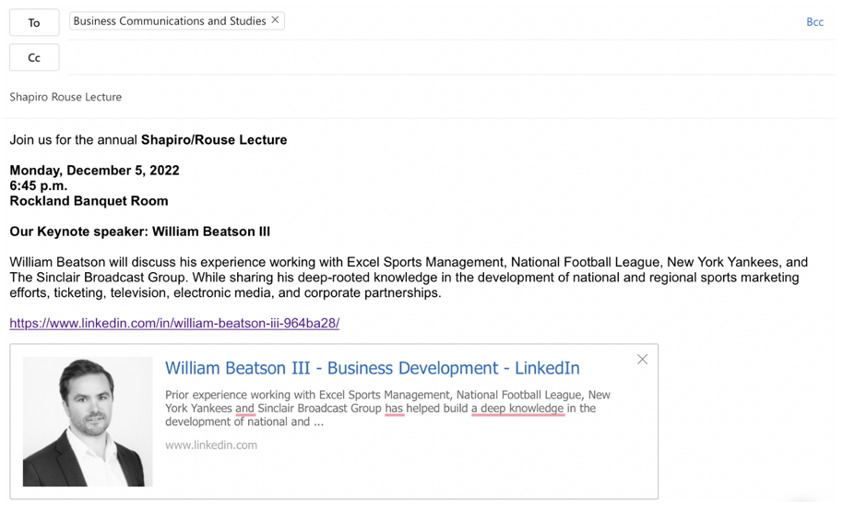
EMAIL TO THE PUBLIC

Slide 5
PHOTO OPP SHEET

Slide 6
SOCIAL MEDIA PLAN
POST 1

Slide 7
SOCIAL MEDIA PLAN
POST 2

Slide 8
SOCIAL MEDIA PLAN
POST 3

Slide 9
FLIER

Slide 10
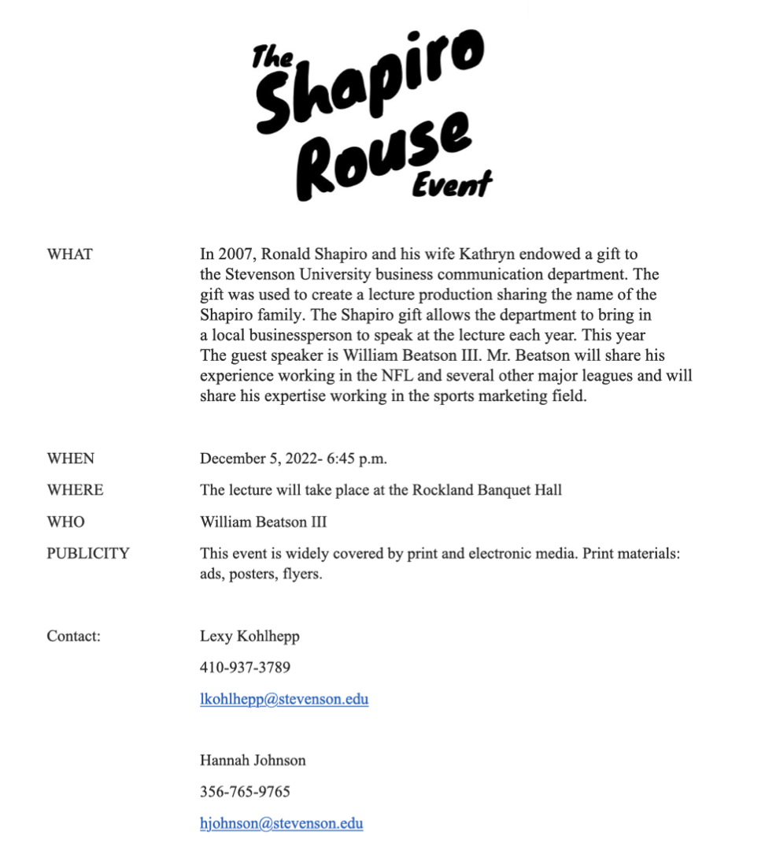
FACT SHEET

Slide 11
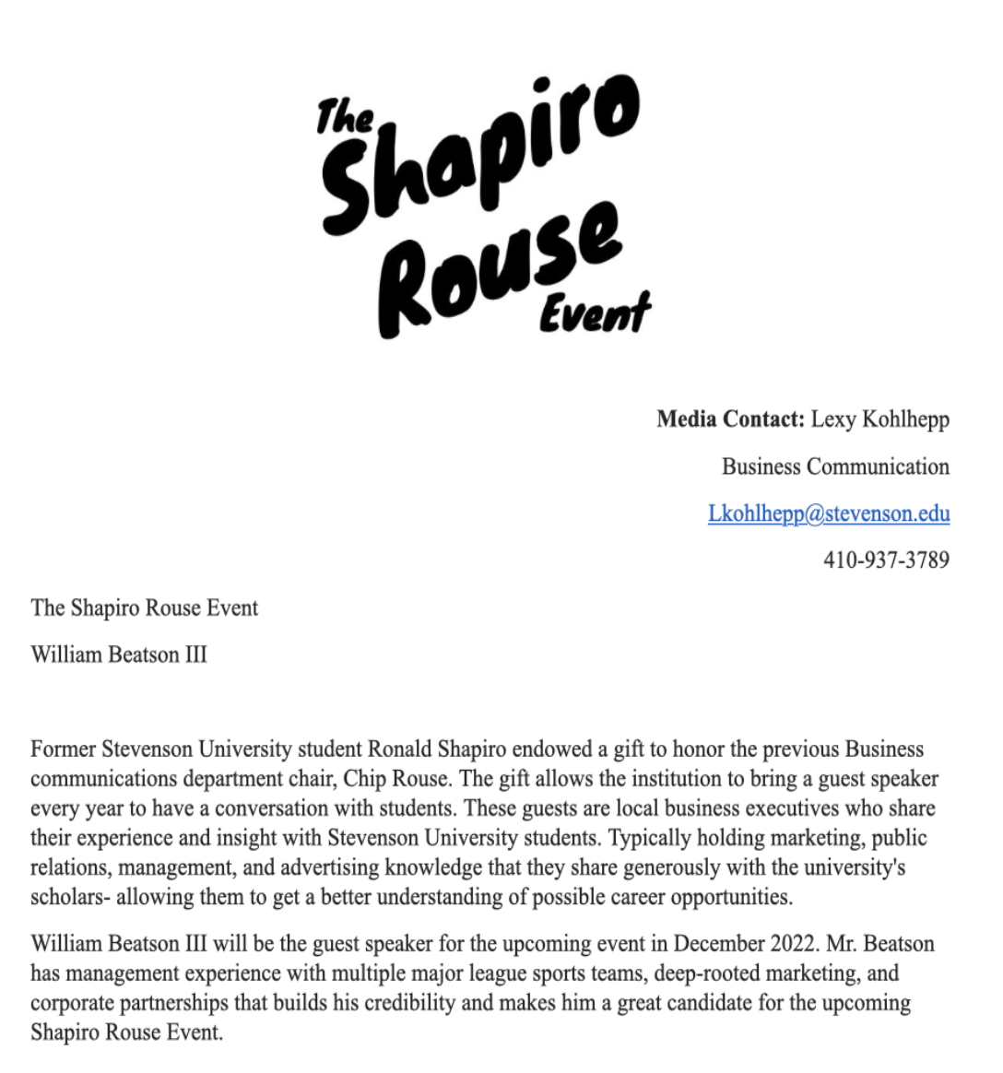
BACKGROUNDER

Slide 12
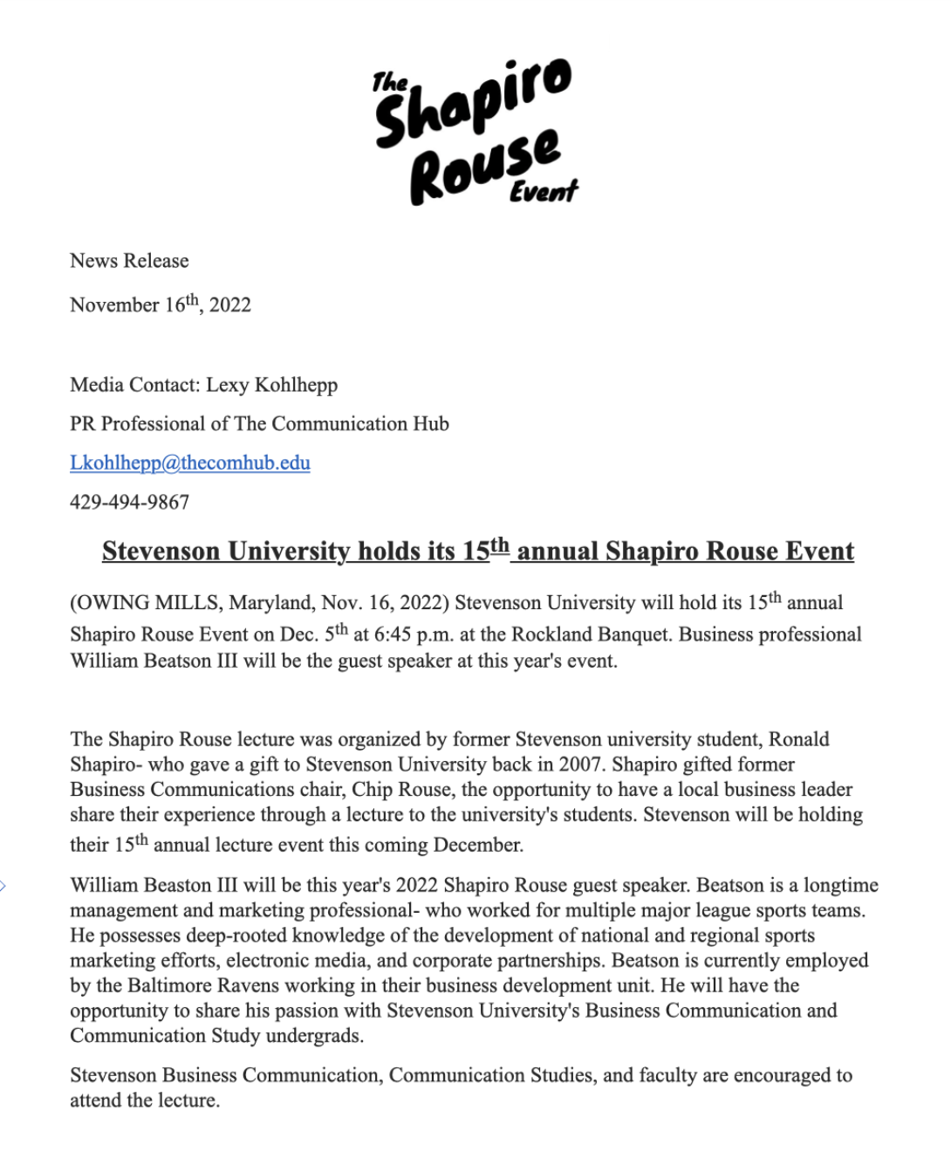
HARD NEWS RELEASE

Slide 13
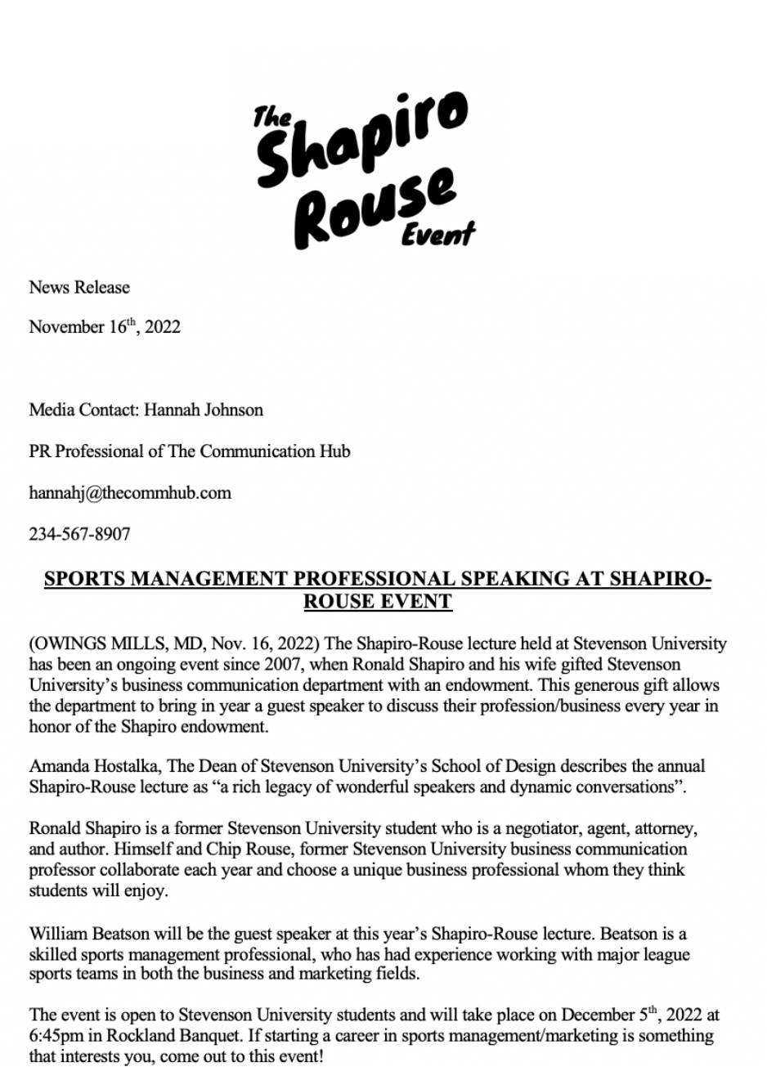
SOFT NEWS RELEASE

Slide 14
Q & A TIME

